Slide 1

Malignant comments classifier project presentation
SUBMITTED BY CHRIS CHHOTAI

Slide 2
introduction
Over the last decade, social media has grown in popularity, allowing users to express themselves and interact with others.
These arguments may emerge as a result of differences of opinion, and they frequently result in confrontations on social media, during which one side may use offensive language referred to as malignant remarks.
This definitely raises the risk of online harassment and abuse.
As a result, some people cease voicing their ideas or stop searching out various viewpoints, resulting in unhealthy and prejudiced debate.
As a result, various platforms and communities find it extremely difficult to allow fair dialogue and are frequently obliged to either limit user comments or shut off user comments entirely.

Slide 3
Problem statement
People can now express themselves widely online because to the advent of social media. However, this has led in the growth of violence and hatred, making online environments unappealing to users. Despite the fact that academics have discovered that hate is a problem across numerous platforms, there are no models for detecting online hate.
Online hatred has been identified as a big problem on online social media platforms, and has been described as abusive language, hostility, cyberbullying, hatefulness, and many other things. The most common venues for such toxic behavior are social media platforms.
On numerous social media sites, there has been a significant increase in incidences of cyberbullying and trolls. Many celebrities and influencers face blowback from the public and are subjected to nasty and disrespectful remarks. This can have a negative impact on anyone, resulting in sadness, mental disease, self-hatred, and suicide thoughts.
Comments on the internet are hotbeds of hatred and venom. Machine learning can be used to combat online anonymity, which has created a new outlet for hostility and hate speech. The issue we were attempting to address was the tagging of internet remarks that were hostile to other users. This means that insults directed towards third parties, such as celebrities, will be classified as non-offensive, whereas "u are an idiot" will be plainly offensive.
Our goal is to create a prototype of an online hate and abuse comment classifier that can be used to classify hate and offensive comments in order to prevent the spread of hatred and cyberbullying.

Slide 4
Dataset description
The data set contains the training set, which has approximately 1,59,000 samples and the test set which contains nearly 1,53,000 samples. All the data samples contain 8 fields which includes ‘Id’, ‘Comments’, ‘Malignant’, ‘Highly malignant’, ‘Rude’, ‘Threat’, ‘Abuse’ and ‘Loathe’.
The label can be either 0 or 1, where 0 denotes a NO while 1 denotes a YES. There are various comments which have multiple labels. The first attribute is a unique ID associated with each comment.
The data set includes:
Malignant: It is the Label column, which includes values 0 and 1, denoting if the comment is malignant or not.
Highly Malignant: It denotes comments that are highly malignant and hurtful.
Rude: It denotes comments that are very rude and offensive.
Threat: It contains indication of the comments that are giving any threat to someone.
Abuse: It is for comments that are abusive in nature.
Loathe: It describes the comments which are hateful and loathing in nature.
ID: It includes unique Ids associated with each comment text given.
Comment text: This column contains the comments extracted from various social media platforms.

Slide 5
Conceptual Background of the Domain Problem
Online platforms and social media become the place where people share the thoughts freely without any partiality and overcoming all the race people share their thoughts and ideas among the crowd.
Social media is a computer-based technology that facilitates the sharing of ideas, thoughts, and information through the building of virtual networks and communities. By design, social media is Internet-based and gives users quick electronic communication of content. Content includes personal information, documents, videos, and photos. Users engage with social media via a computer, tablet, or smartphone via web-based software or applications.
While social media is ubiquitous in America and Europe, Asian countries like India lead the list of social media usage. More than 3.8 billion people use social media.
In this huge online platform or an online community there are some people or some motivated mob willfully bully others to make them not to share their thought in rightful way. They bully others in a foul language which among the civilized society is seen as ignominy. And when innocent individuals are being bullied by these mob these individuals are going silent without speaking anything. So, ideally the motive of this disgraceful mob is achieved.
To solve this problem, we are now building a model that identifies all the foul language and foul words, using which the online platforms like social media principally stops these mob using the foul language in an online community or even block them or block them from using this foul language.

Slide 6
Multilabel vs Multiclass classification
Because the goal was to determine if the data belonged to zero, one, or more than one of the six categories in our dataset, the first step was to distinguish between multi-label and multi-class classification.
We have one essential assumption in multi-class classification: our data can only correspond to one label out of all the labels we have. An apple, orange, or guava, for example, may be the sole fruit depicted in a given image, rather than a combination of these.
Data can be assigned to multiple labels at the same time in multi-label classification. In our instance, for example, a comment could be toxic, lewd, and disrespectful all at the same time. It's also possible that the comment isn't harmful and hence doesn't fit into any of the six categories.
As a result, I was faced with a multi-label categorization problem. The next step was to use data to acquire some important insights that would help with future problem solving.

Slide 7
DATA SCIENCE LIFE CYCLE
Data Cleaning
Import the collected data from web scraping
Exploratory Data Analysis
Check through all the dataset information like datatype, missing value, duplicate value etc.
Visualization and Data Preprocessing
Use various visualization methods to check the data distribution identify presence of outliers and skewness
Clean and format the records as per usage by using various imputation techniques
Analyze each and every data record to ensure we have usable information
Perform encoding and scaling methods

Slide 8
DATA SCIENCE LIFE CYCLE
Model Building
Create appropriate Regression Machine Learning model function
Model Evaluation
Usage of evaluation metrics to check the accuracy of the models over trained and test data inputs
Hyperparameter Tuning Best Model
Choosing the appropriate Regression Machine Learning model to check various parameter permutation and combinations
Need to ensure that whenever the regression function is called it can process all the necessary parameters
Ensure the cross-validation techniques helps in reducing over fitting and under fitting data
Using Grid Search CV to obtain the best parameters that can be plugged into the selected model

Slide 9
MODEL BUILDING STEPS
1. Data Cleaning
2. Exploratory Data Analysis
3. Data Pre-processing
4. Model Building
5. Model Evaluation
6. Selecting the best model

Slide 10

Data preprocessing
1. Load dataset
2. Remove null values
3. Drop column id
4. Convert comment text to lower case and replace '\n' with single space.
5. Keep only text data i.e. a-z' and remove other data from comment text.
6. Remove stop words and punctuations
7. Apply Stemming using SnowballStemmer
8. Convert text to vectors using TfidfVectorizer
9. Load saved or serialized model
10. Predict values for multi class label

Slide 11
TECHNOLOGY USED
Hardware technology being used.
RAM : 16 GB
CPU : 11th Gen Intel(R) Core(TM) i7-11390H @ 3.40GHz 2.92 GHz
Software technology being used.
Programming language : Python
Distribution : Anaconda Navigator
Browser based language shell : Jupyter Notebook
Libraries/Packages specifically being used.
Pandas, NumPy, matplotlib, seaborn, scikit-learn, NLTK

Slide 12
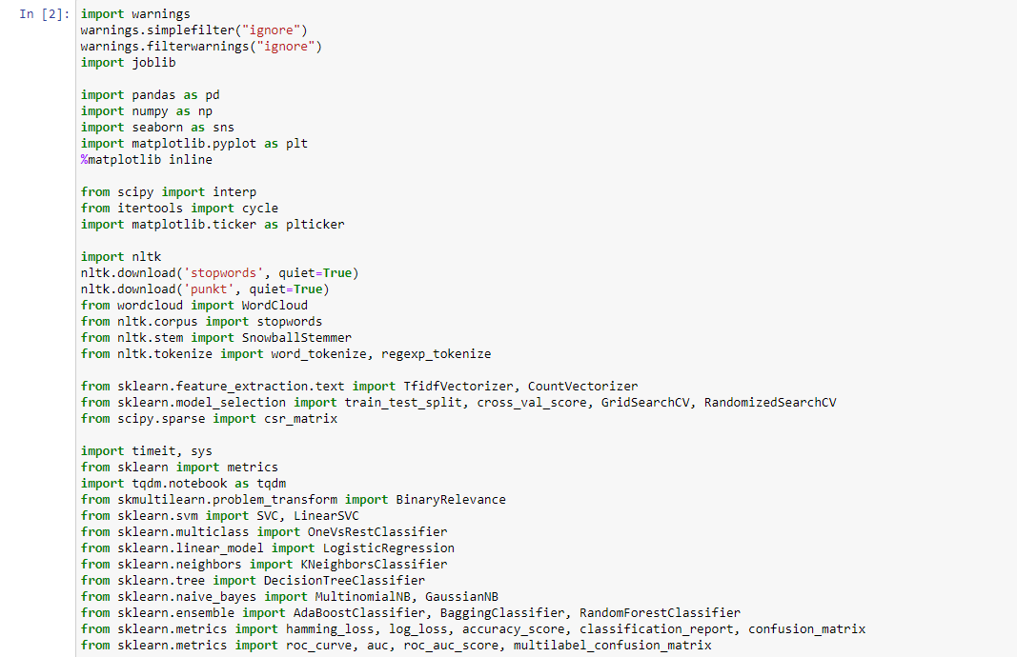
Imported dependencies

Slide 13
EXPLORATORY DATA ANALYSIS (EDA) AND VISUALIZATION
01. Univariate Analysis
02. Multivariate Analysis
03. Correlation of Dataset
Univariate analysis is the simplest form of analyzing data. “Uni” means “one”, so in other words your data has only one variable.
Multivariate analysis is a set of statistical techniques used for analysis of data that contain more than one variable.
Correlation is used to test relationships between quantitative variables or categorical variables.
04. Correlation with Target variable
05. Conclusion
Correlation with the target variable to know how the data is related.
Summary with the conclusion of all the analysis

Slide 14
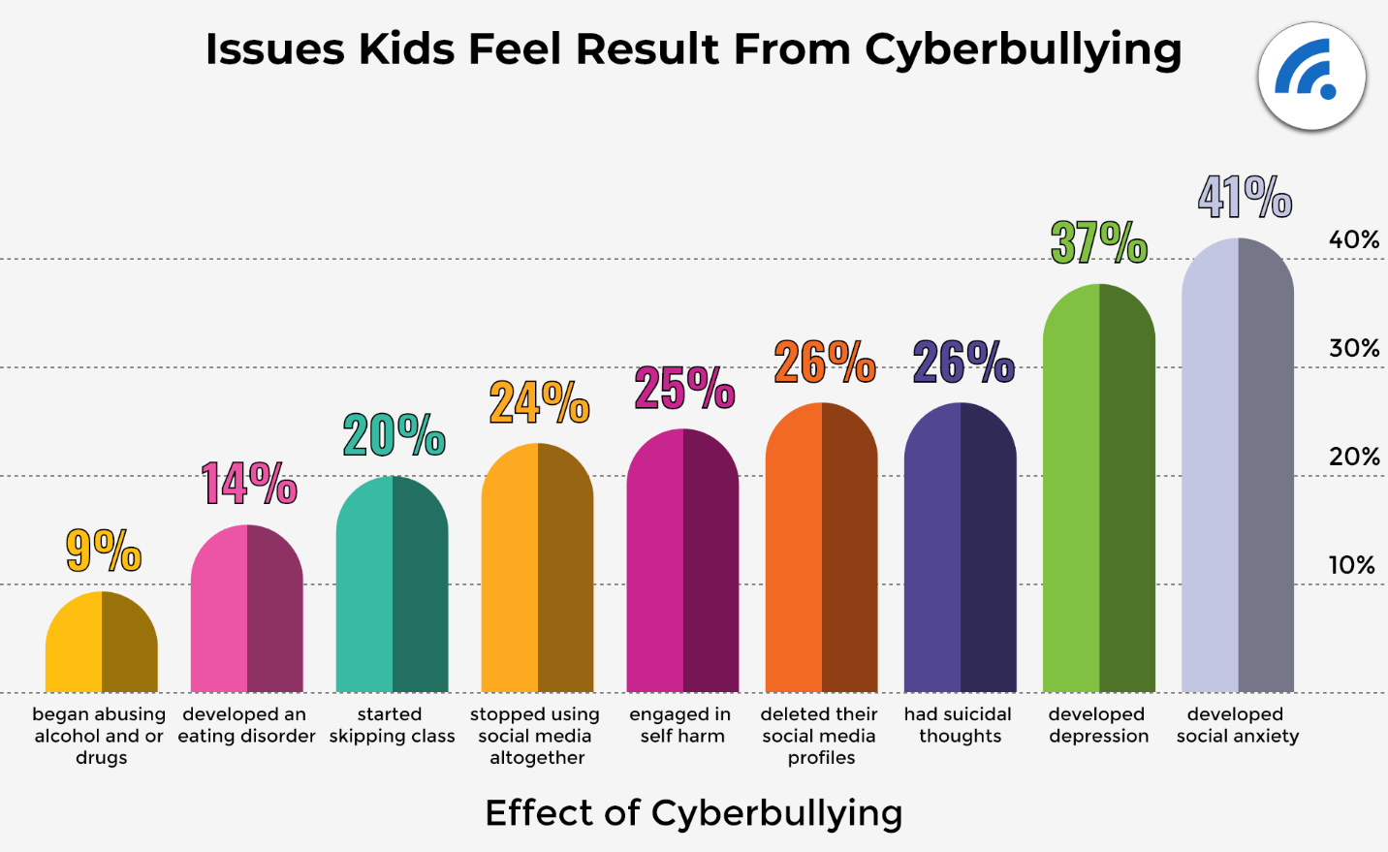
Cyberbullying statistics
Cyberbullying is becoming more prevalent in countries all around the world. In essence, cyberbullying is very similar to the type of bullying that many children have become accustomed to at school. The only difference is that it is conducted entirely online.

Slide 15
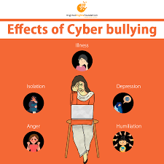
Effects of cyberbullying
Cyberbullying is a severe problem that affects not only the young victims, but also their families, the bully, and anyone who witness cyberbullying. Cyberbullying, on the other hand, can have the greatest negative impact on the victim, as they may experience a variety of emotional disorders that influence their social and academic performance, as well as their overall mental health.

Slide 16
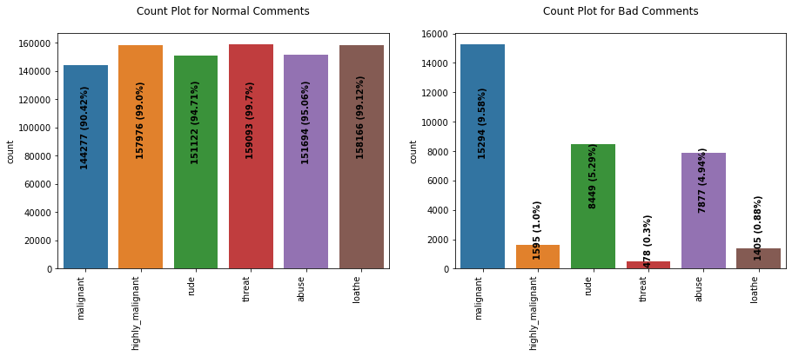
Count plot

Slide 17
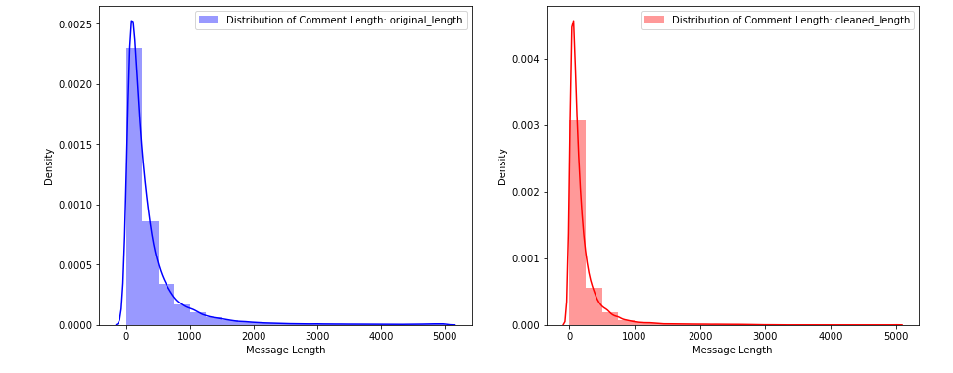
Distribution plot

Slide 18
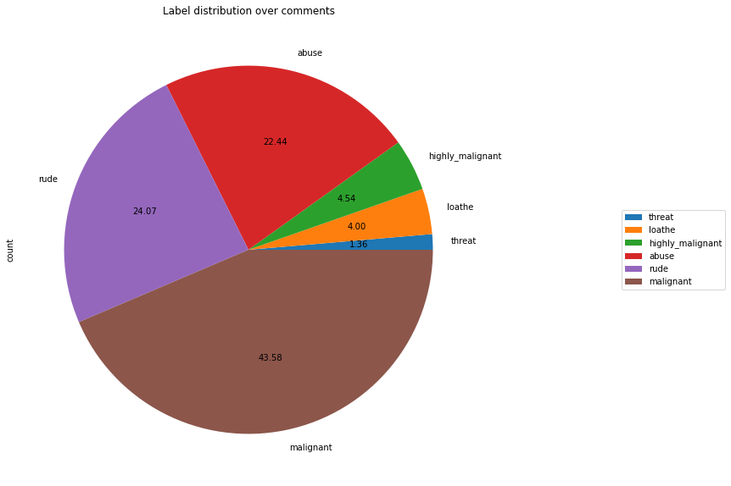
Pie plot

Slide 19
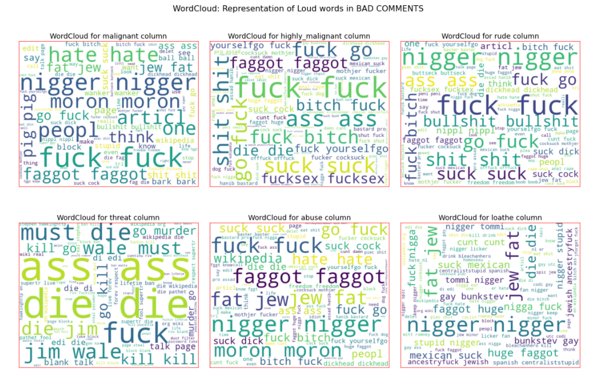
Word cloud

Slide 20
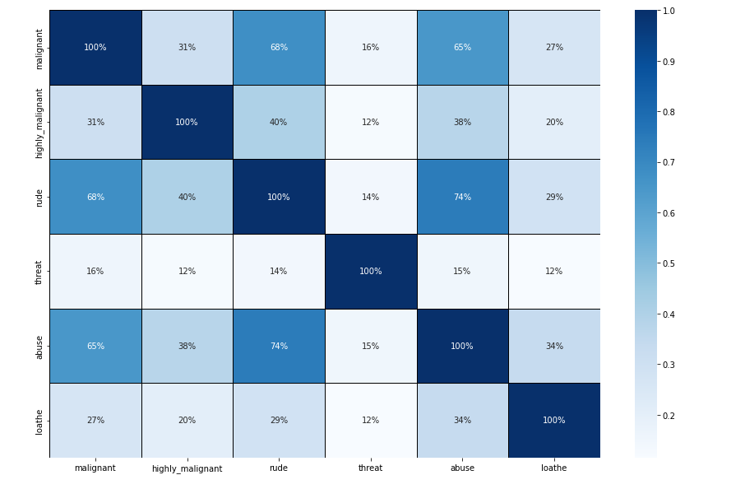
heatmap

Slide 21
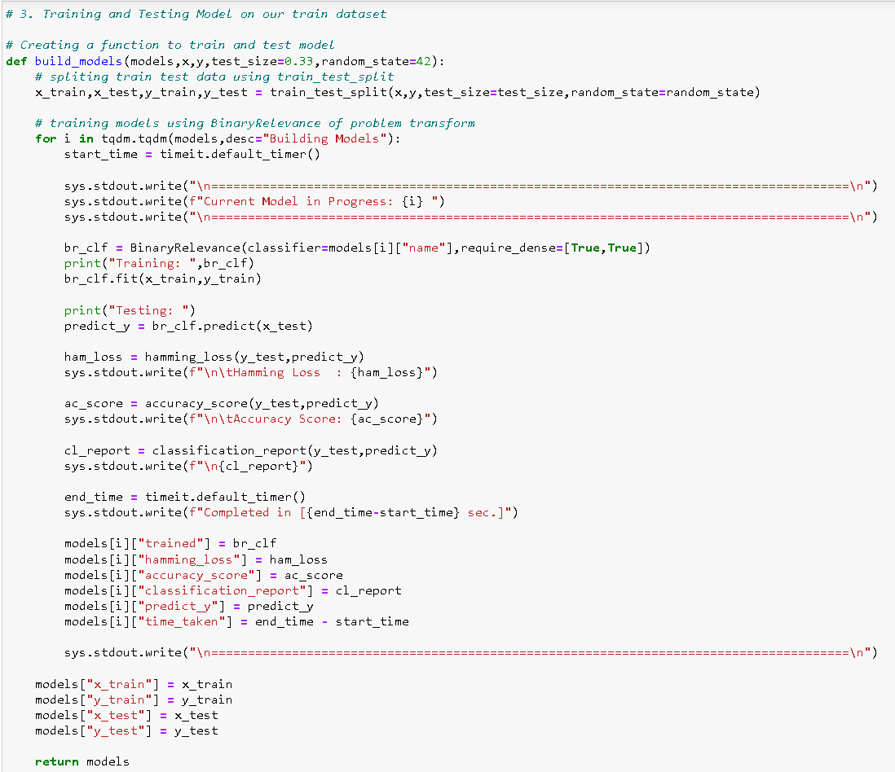
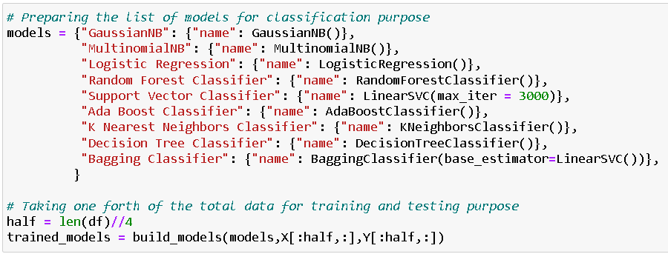
Classification function

Slide 22
Classification machine learning models

Slide 23
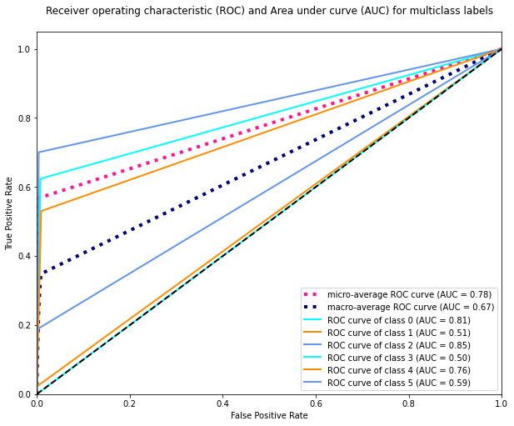
ROC AUC CURVE

Slide 24
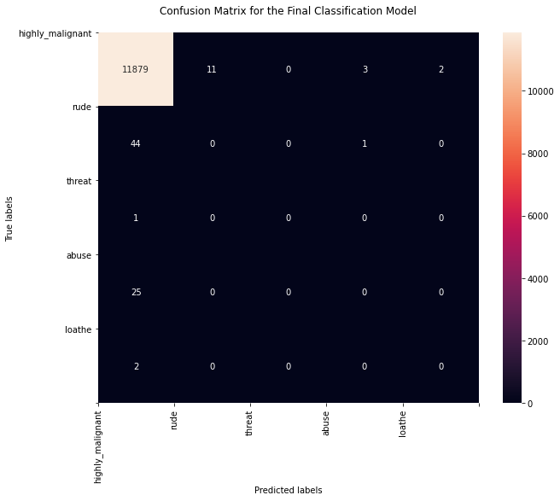
Confusion matrix

Slide 25
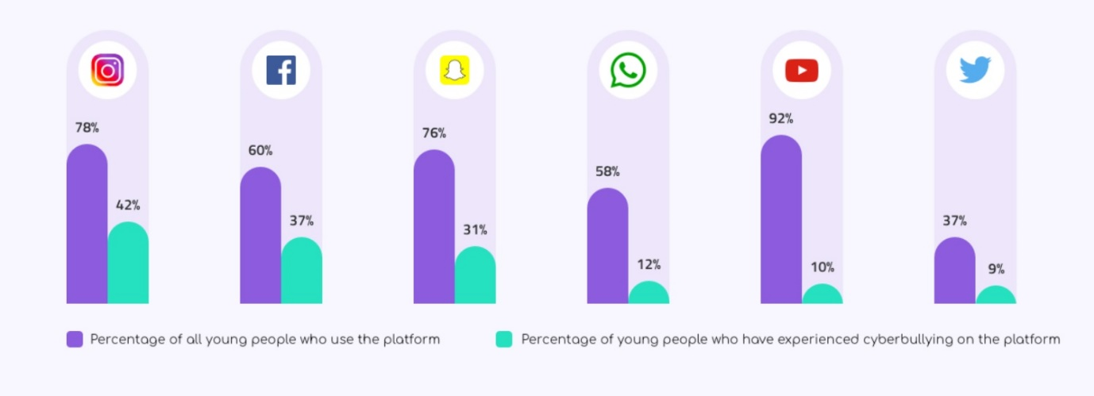
Key Findings and Conclusions of the Study
The survey discovered that just a small percentage of online users use unparliamentary language.
And most of these phrases contain a lot of stop words and are pretty long.
As previously said, a few motivated rude mobs use harsh language in internet forums to bully individuals and prevent them from doing what they are not supposed to do.
Our research aids online forums and social media in enforcing a prohibition on swearing or the use of profanity on these platforms.

Slide 26
Learning Outcomes of the Study in respect of Data Science
We learned several natural language processing techniques through this research, such as lemmatization, stemming, and stop word removal. Through the hash vectorizer, we were also able to learn how to turn strings into vectors. We used a variety of evaluation criteria in this research, including log loss and hamming loss, in addition to accuracy.

Slide 27
Learning Outcomes of the Study in respect of Data Science
My project's conclusion is that we should use good, courteous language in social media and avoid using abusive, vulgar, and derogatory terms. It has the potential to produce a slew of issues that will have an impact on our life. When dealing with tension and negativity, try to be polite, calm, and composed; one of the greatest methods is to ignore it and overcome it in a constructive way.

Slide 28
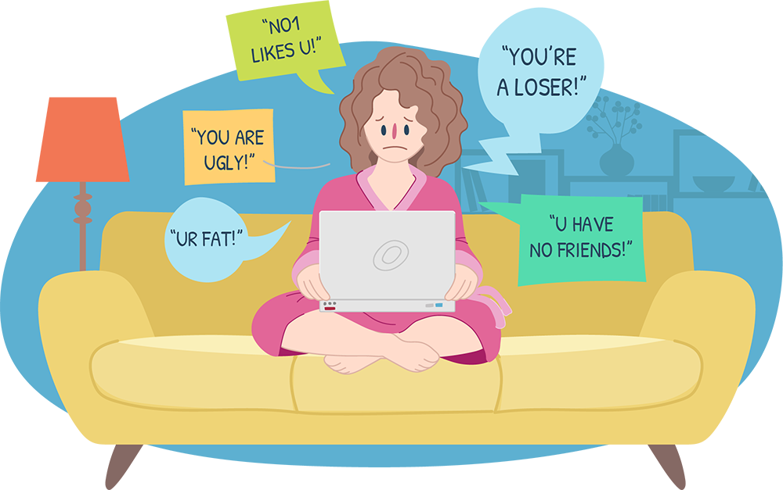
Limitations of this work and Scope for Future Work
Problems faced while working in this project:
Because it took more than 2 hours, more computational power was required.
Imbalanced dataset and bad comment texts.
Because time was consumed more, good parameters could not be acquired through hyperparameter tuning.
Areas of improvement:
Could be given a good dataset that doesn't take too long.
Time complexity is reduced.
Creating a well-balanced dataset with fewer errors.

Slide 29


